Slide 1
FF STEEL People’s and Culture Department Overiew
“Continuously striving for better workplace and better world”.

Slide 2
KPI’s Based Culture
Company Goal
Step 01
Step 02
Step 03
Strategic Mission
Departmental KPIs
Section KPIs
Company Yearly Goals
(approved by BOD along with SMT)
Indiviual KPIs
Periodic Assessments by
Audit Department.
Self Audit – Section Wise.
Departmental Review.
Increments.
Promotions.
Fairness of the Program.

Slide 3
Polices, Procedures & ETE Automation
SOPs/Policies
Manuals & Booklets
Automation
(End to End)
Trainings/Simulations (Demo)

Slide 4
FF Diversity & Inclusivity
No Glass Ceiling
(Male & Female got equal access to advancement)
Religious Pluralism
Geographic
No Glass Cliff
(Minorities can ascends to higher positions)
Demographic
No Tokenism

Slide 5
Training & Development
ET
External Trainings
Needs Identification – TNA.
Yearly Calendar.
Exhausting Allocated Budget.
IT
Internal Trainings
Daily / Monthly / Quarterly.
Orientations
General Orientation.
Line Orientation & Socializing.
Mega Orientation (Quarterly)
O
A
Assessment
Pre Analysis.
Post Analysis.
Needs Identification & Changes Incorporation.
Impact on Job.

Slide 6
Community Development Initiatives & Capacity Development Programs
KP TEVTA – Skill Program
STEEL FIXER – Skill Program
1st Pilot Program in Pakistan
(Technicians for Steel Industry)
In-House Curriculum Development
Course Approval from NAVTCC
3rd Batch Started– Average 71 Students Participated - Placements
Collaboration with PITAC
Government Accredited Certificate
5th Batch Ongoing – Average 30 Persons/Batch
MTO – Program
UNDP – FATA
Managements Program
(LUMS, IBA, NUST, IM Sciences etc.)
3rd Batch
Retention Ratio > 30%.
Capacity Development – Internships - Jobs

Slide 7
Few Success Stories
Mr. Irfan
Mr. Alam
Mr. Amin
Ms. Iqra
Ms. Falak
Intern to CITO
Accountant to CWO
Office Boy to Sales Executive
Intern to Section Head (Digital Marketing)
Coordinator to Manager Sales

Slide 8
The Industry-Academia Skills Gap

Slide 9
Offered Skills- Acedemia | In-Demand skills- Industry
Java, Window based applications | Product based knowledge Required SAP, Oracle
Static/ Mini Mobile application | Flutter/ AWS/ Re-Acnative with Client Server integration with industries ERP
C/ C++ | C#/ Csharp with Machine integration
Wordpress | Laravel, Codignitor with Server database not on local host
MATLAB | SQL Server Administration/ DBA/ Crystal Reports
Paython | GCM, FCM, Sift/ IoS, Macbook or apple products
MySQL, VBA, SPSS | Microsoft Azure
PHP | Personality, Attitude and Work ethics
Unity, Research Based FYP | Problem solving, ability to learn and adaptability
Start project in 6th or 7th semester | Start project and tools from 2nd or 3rd semester with relgular visit to relevant firm
Oudated books and material | Books and material should be up to date

Slide 10
IT Resources at FF Steel

Slide 11
Tools/ Products used by FF Steel
SAP Business One with SQL Server
Integrated Mobile applications developed in Flutter (hybrid)/ Kotlin/ JAVA
Integrated Software in C#
Portals in Laravel/ PHP
Jira for project management
Crystal Reports
SAP Studio for development in SAP

Slide 12
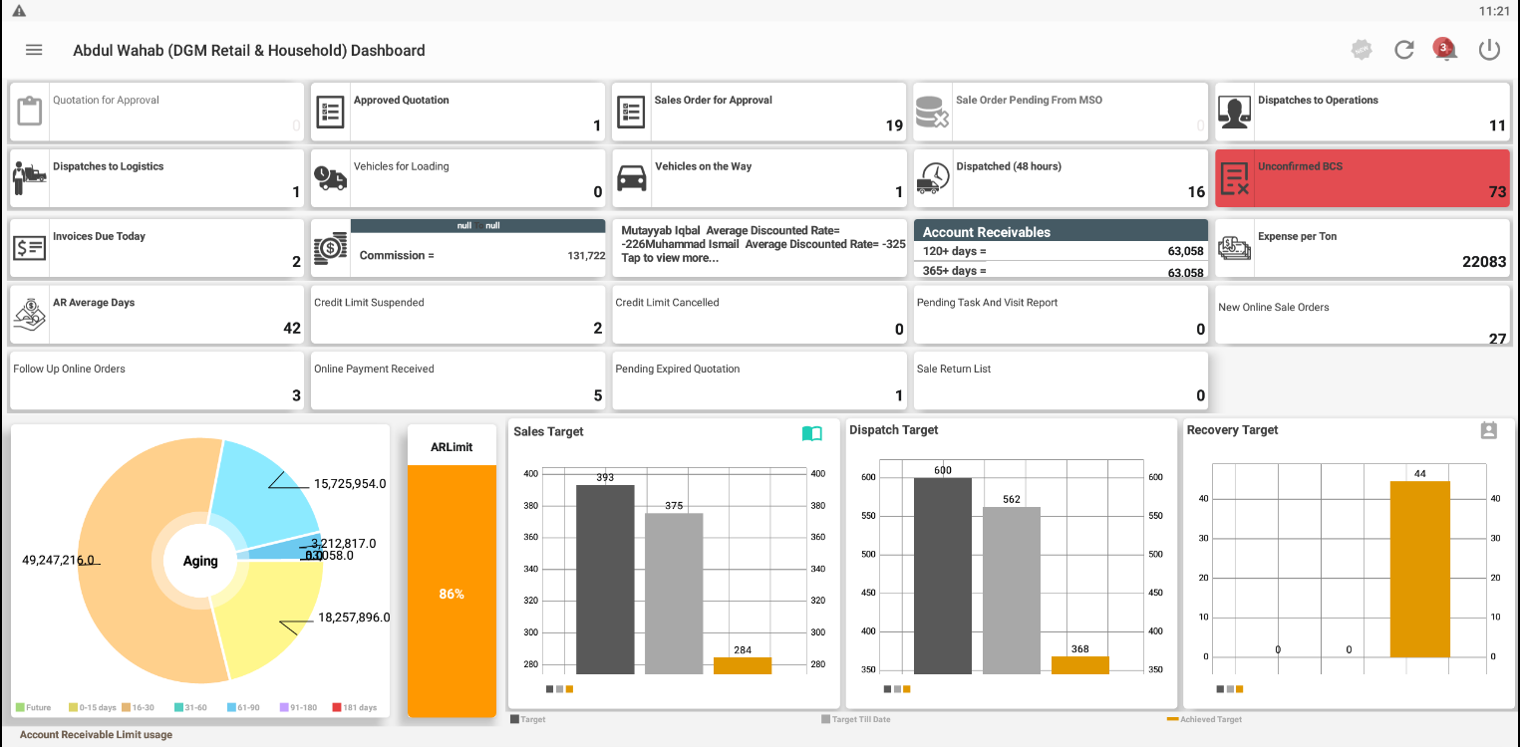
CRM (Android Application)

Slide 13
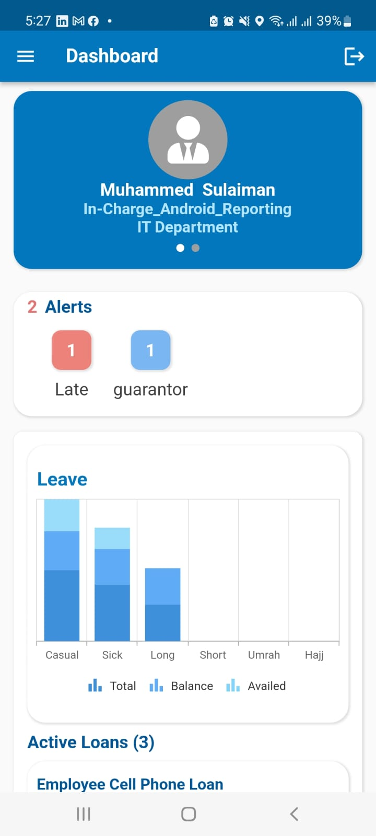
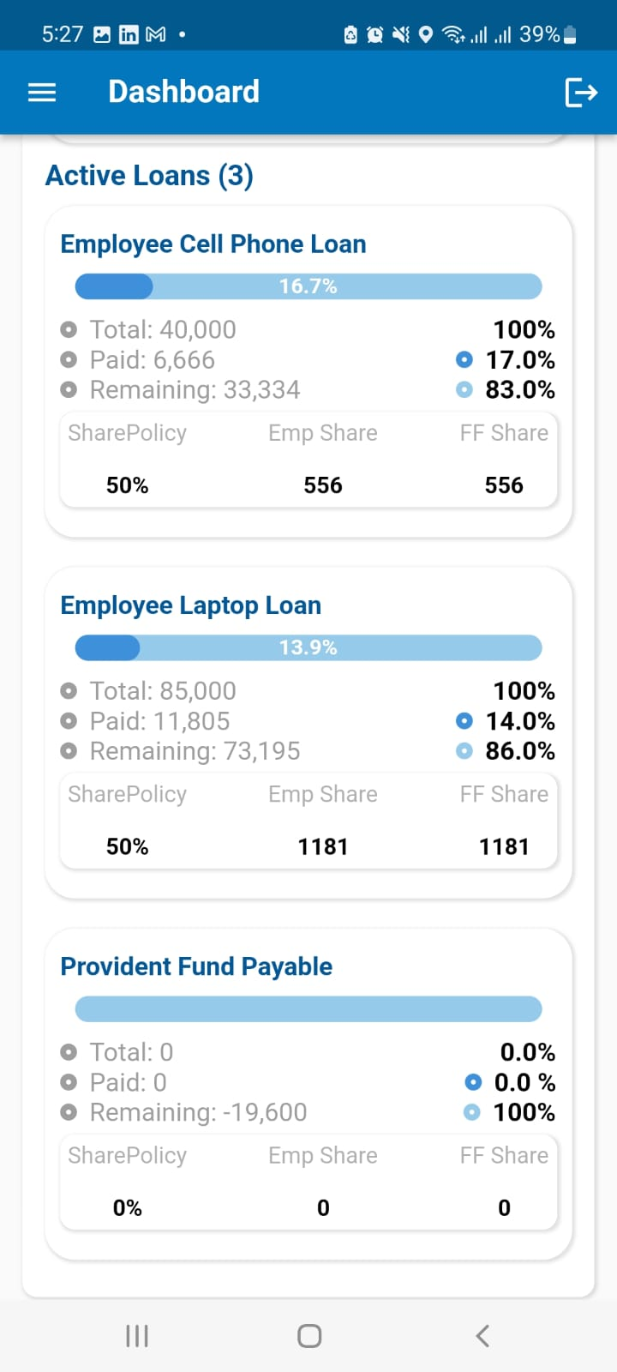
HRMS(Android Application)
This App is used for HR policies

Slide 14
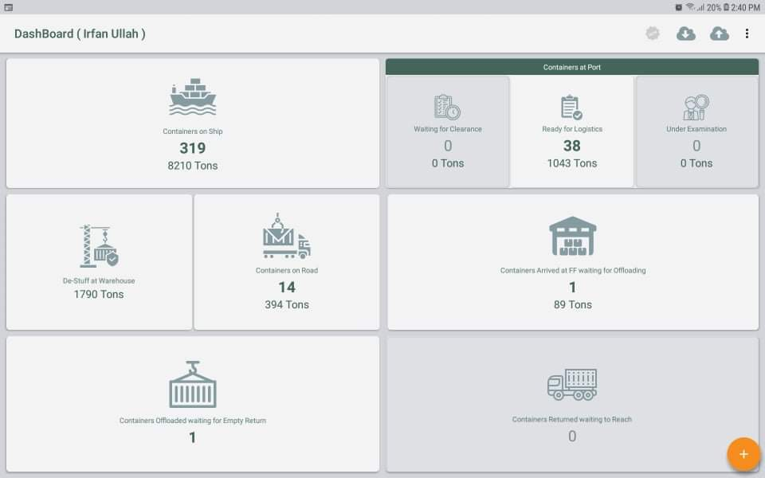
Import Tracking (Android Application)

Slide 15
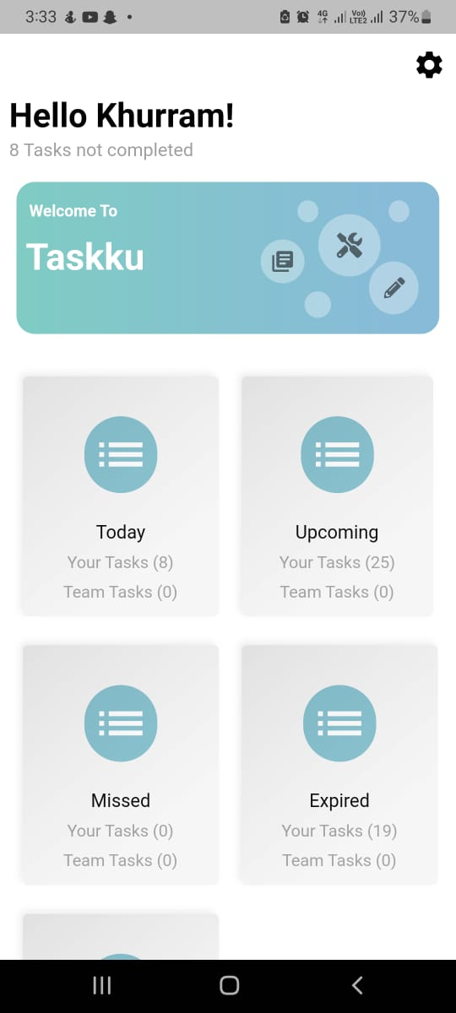
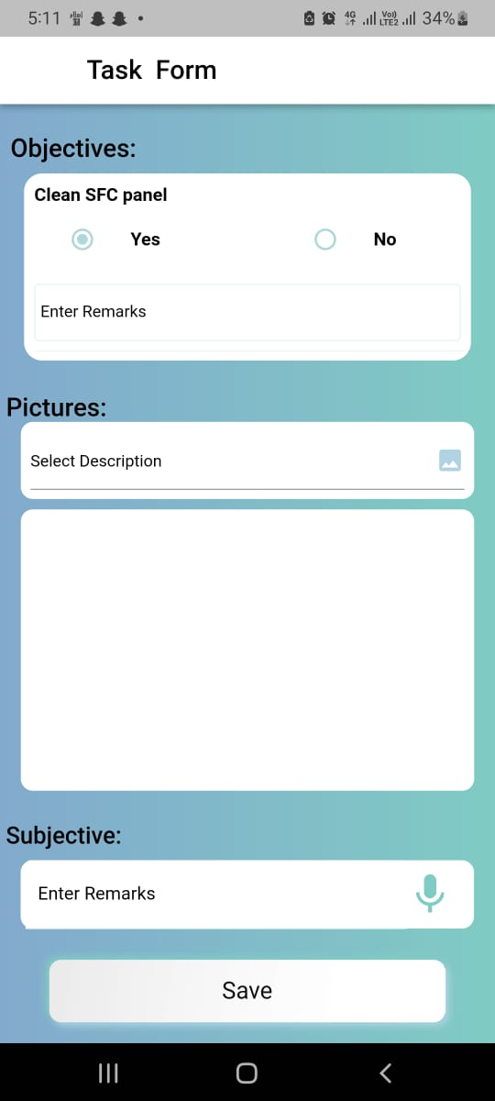
Taskku

Slide 16
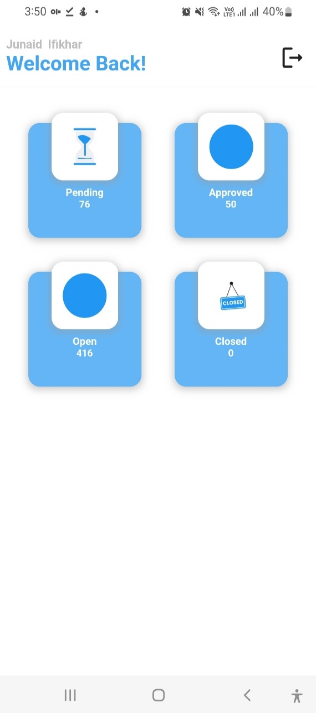
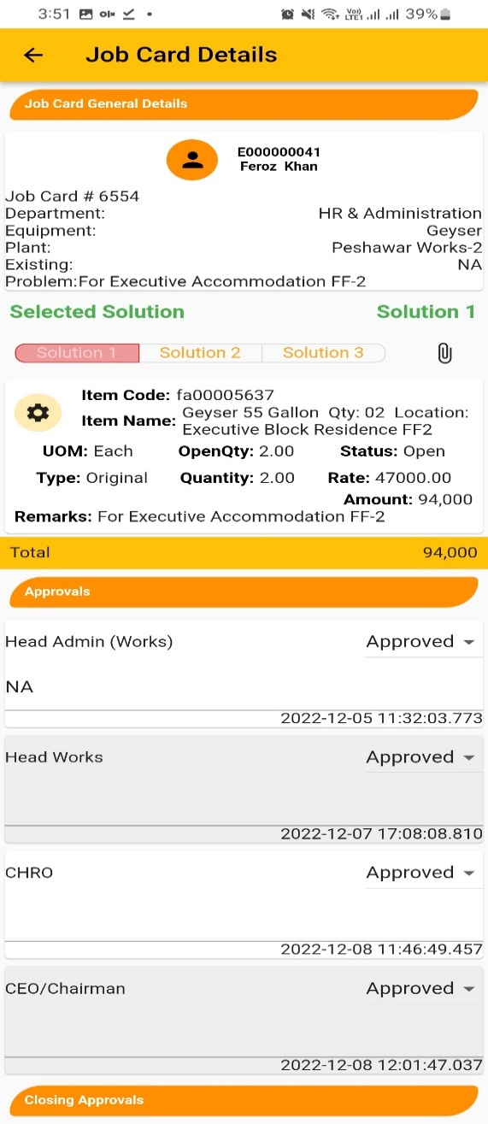
Job Card (Android Application)
The use of job card is to make a purchase request

Slide 17
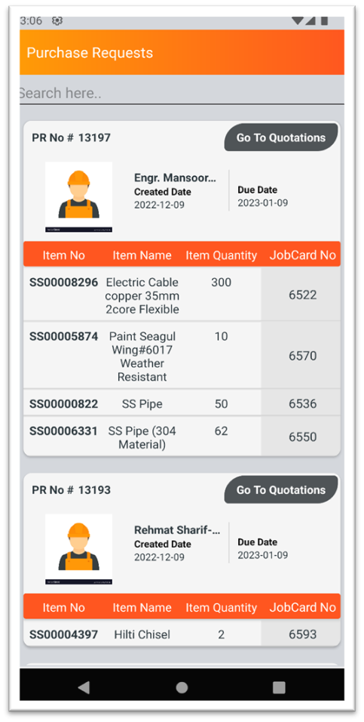
Procurement (Android Application)
This App is used to take the quotation

Slide 18
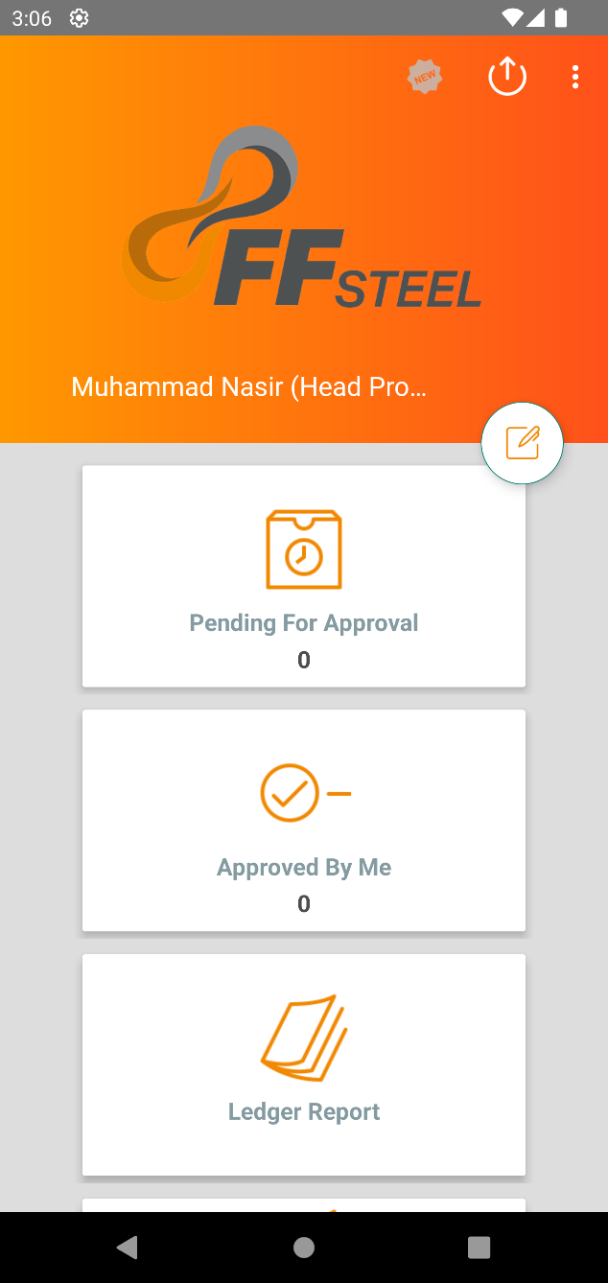
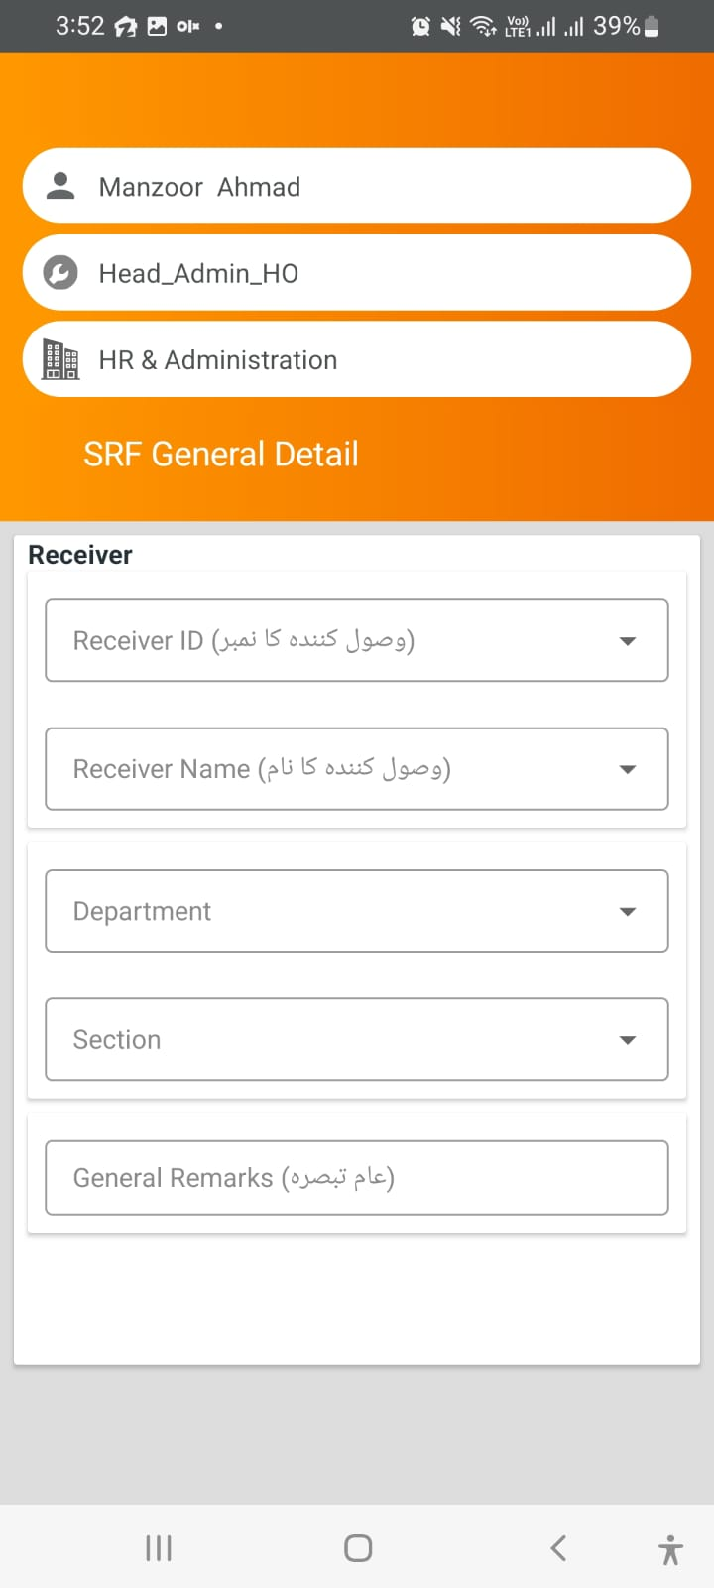
Store Issuance (Android Application)
This App is used to issue the items from store

Slide 19
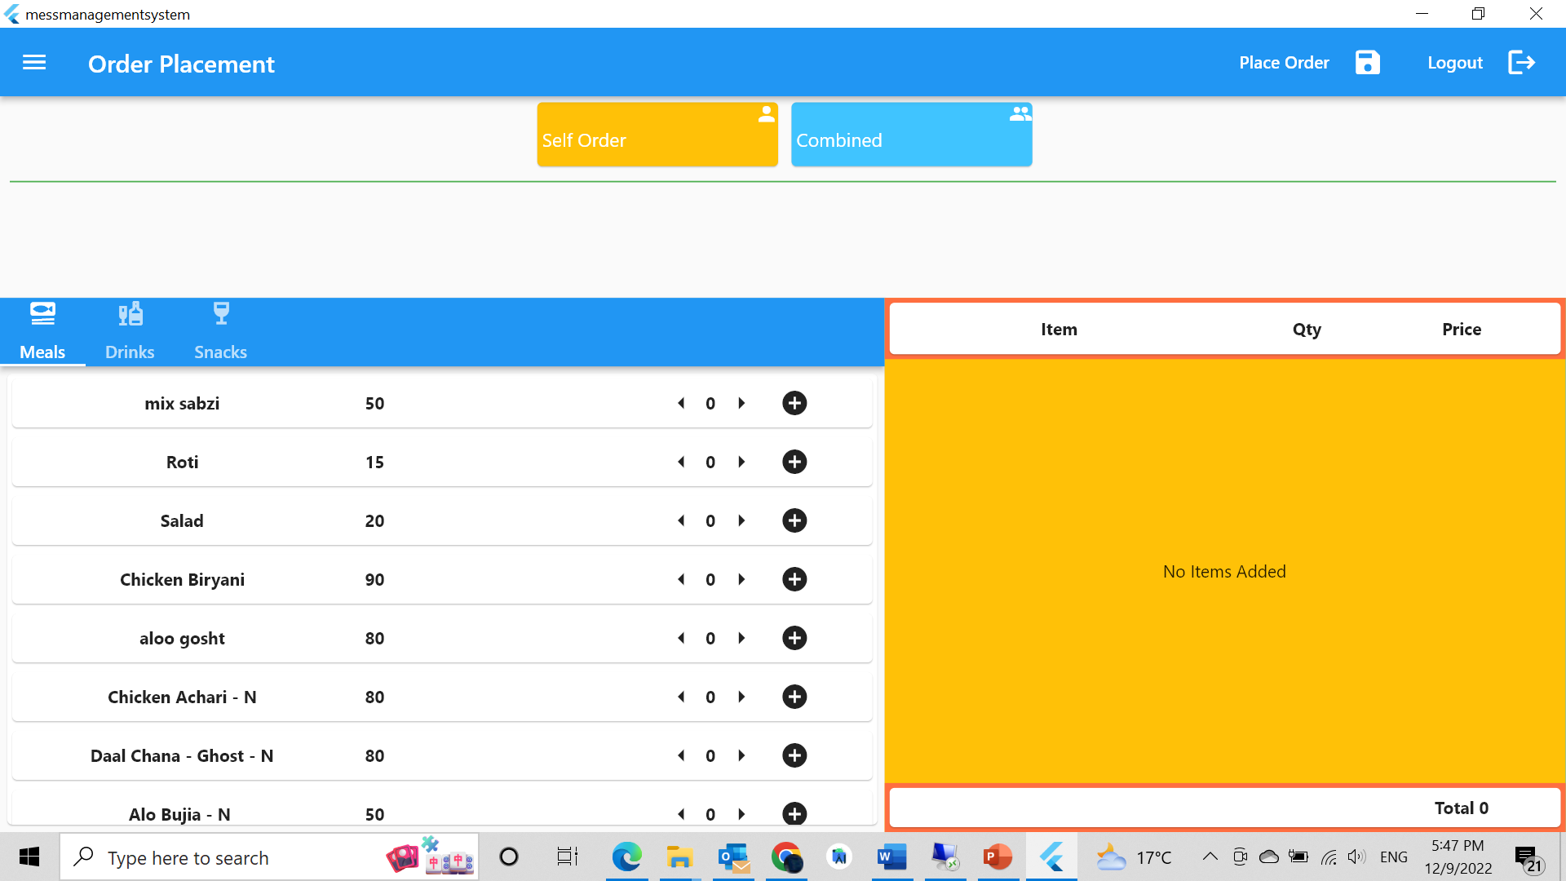
Mess Management System

Slide 20
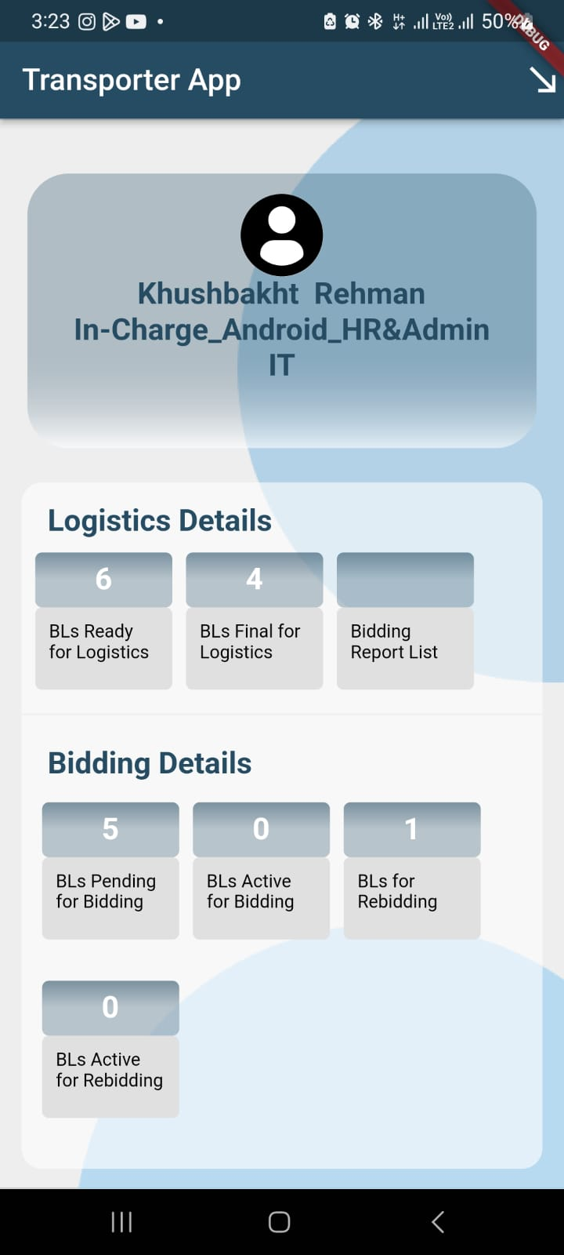
Transporter App (Android Application)
Fast and secure bidding process
Different type of rates in database
Digitalization of bilty process
Transparency in bidding process

Slide 21
Thank you

Slide 22
Partnership of Industries with Government Departments
Presented by:

Slide 23
It is impossible to run an industry in Pakistan without cooperating with the following government departments.
Sr. No. | Department Name | Overview
1. | LGCD (Local Government and Community Development Department). & TMA / LDA | Approval of Building Drawings (Building Planning Section). Collection of Business Tax Collection of Advertisement Tax Collection Water Tax The Local Government and Community Development Department (LGCD) has been assigned the responsibility to implement Punjab Local Government Act (PLGA) 2022 to achieve the stated objectives of the Government. Moreover, the LGCD Department has an over-seeing role to ensure that the local governments perform their functions within the provincial framework and adhere to the federal and provincial laws. The Local Government and Community Development Department (LGCD) was created to respond to the specific needs of the mega cities and largely urban districts of Punjab for good governance.
2. | EPD (Environment Protection Department) | Environmental degradation is escalating rapidly at the national and global level. Environment Protection Department, Punjab was established to combat this problem. Environment Protection Department, Punjab created Environment Protection Agency (EPA) which is responsible for the protection, conservation, rehabilitation and improvement of the environment; the prevention and control of pollution and promotion of sustainable development in the province. EPA is building on its successes through reliable and effective legislation about environment protection and highquality service delivery. EPA sustains qualitative and quantitative standards for the discharge of effluents, wastes, air emissions or noise either for general applicability or for a particular area or from a particular source in the form of Punjab Environmental Quality Standards (PEQS) and other standards established under the laws, rules and regulations. Following Approvals and NOCs are must to run an industry; EIA – Environmental Impact Assessments. NOC 1 – Authority to issue building construction NOC. NOC 2 – Authority to issue NOC to start industry operations. Industrial Wastes Management Contracts Approval. Quarterly Monitoring Reports SMOG Inspections
3. | Labour & HR Department | Labour & Human Resource Department Punjab is established under the Punjab Government Rules of Business, 1974. Labour & HR Department inspects annually the Workers Payroll, Leave Records, Building Safety, Workers Welfare Allowances, Bonuses, Overtime and Duty Hours.

Slide 24
4. | ESSI (Employees Social Security Institution) | The Punjab Employees Social Security Institution (PESSI) is an autonomous body working under the administrative control of Labour and Human Resource Department as per Punjab Government Rules of Business, 1974 and was established through the Provincial Employees Social Security Ordinance, 1965. The provision of health facilities to the workers and their dependents is covered under the Provincial Social Security Laws. The Provincial Employees Social Security Ordinance, 1965 requires the employers to contribute 6% of the wages of their employees to the Punjab Employees Social Security Institution.
5. | EOBI (Employees Old-Age Benefits Institution) | EOBI Act 1976 was enforced with effect from April 01, 1976, to achieve the objective of Article 38 (C) of the Constitution, by providing for compulsory social insurance. It extends following benefits to insured persons or their survivors:-, Old-Age Pension Survivor's Pension Invalidity Pension Old-Age Grant
6. | Chamber of Commerce | The Chamber of Commerce & Industry was established in 1923. It was established to serve and represent the interests of the business community.
7. | Civil Defense / RESCUE 1122 | Civil Defense Inspector inspects Industries Building Fire Safety, Emergency Evacuation Plans, Fire Hydrants, Emergency Sirens, Assembly Areas, Safety Drills Record. Civil Defence Department is an organization that pool the national resources to conduct and control civil defence of the people to minimize the effects of enemy air attacks. The administrative department of the Civil Defence Department is the Home Department, Government of the Punjab. It has district level set up in the 36 districts of Punjab which operate under the command control of Deputy Commissioner who are ExOfficio Controller Civil Defence.
8. | Health Department | Inspects workers health related issues (Safe working environment) Inspects Industries premises regarding Mosquitos (Dengue) related problems. Industries Canteens Inspections & Issuance of Hygiene Certificate / Canteen License

Slide 25
9. | Excise, Taxation & Narcotics Control Department | The Excise, Taxation and Narcotics Control Department provides services for collection of various taxes and duties efficiently and effectively and suggests ways and means for additional resource mobilization in the Province. Apart from building up of taxpayer’s confidence, creation of taxpaying culture and providing facilities to the general public in payment of taxes are the top most priorities. Collection of Professional Tax Collection of Property Tax
10. | LESCO (Lahore Electric Supply Company) | LESCO is an electricity power distribution company to distribute electricity in a reliable, secure, safe, environmentally responsible & cost-effective manner
11. | SNGPL (Sui Northern Gas Pipelines Limited) | Sui Northern Gas Pipelines Limited (SNGPL) was incorporated as a private limited Company in 1963 and converted into a public limited company in January 1964 under the Companies Act 1913, now The Companies Act 2017, and is listed on the Pakistan Stock Exchange (PSX). The Company falls under the category of Public Interest Company under the Third Schedule of the Companies Act, 2017.
12. | Weights & Measurement | The Weights & Measures Inspector visits the industry every year and issues a certificate (After payment of Government Fee) after inspection of all the weighing and measuring instruments.
13. | PSQCA (Pakistan Standards & Quality Control Authority) | The Pakistan Standards & Quality Control Authority is an autonomous body subordinate to the ministry of science and technology of the Government of Pakistan. Its main objective is to regulate and enforce quality standards in Pakistan. Anything that is certified by the PSQCA is issued the Pakistan Standards label.
14. | Highway Division | All industries require permission / NOC from the Highways Department to install polls, lay cables above or below any road
15. | Police | Police assistance is often required to protect the areas around and inside industries.

Slide 26
Marketing
Case Study Method
Experiential Learning
Real Time Final Year Project
Effective Communication & Presentation Skills
MS Office Suite
Data Analysis Tool
Customer Relationship Management (CRM) Software
Digital Marketing

Slide 27
THANK YOU

